Slide 1

DSC530 Final project inventory management by kausik chattapadhyay Date: 03/01/2023

Slide 2
Agenda
Agenda
Inventory Management Problem Statement
Dataset Info
Univariate Distribution Plots
Outlier Detection Plots
Bivariate Plots
Correlation Plots and columns to be selected for modelling
Univariate Outlier Treatment
Predictive Modelling
Statistical Hypothetical Summary

Slide 3
Problem Statement
• Context: A retail firm has many products in their inventory, and very few of them tend to sell (only about 10% sell each year) and many of the products only have a single sale in the course of a year
• Objective: The sales and growth team of the retail firm wants to determine which products from their inventory should they retain to sell and the ones to discard
• Data: The data given contains both historical sales data AND active inventory
• Goal: We have a to building a binary classifier which gives us a list of product ID which need to retained in the inventory or list of products that need to be removed

Slide 4
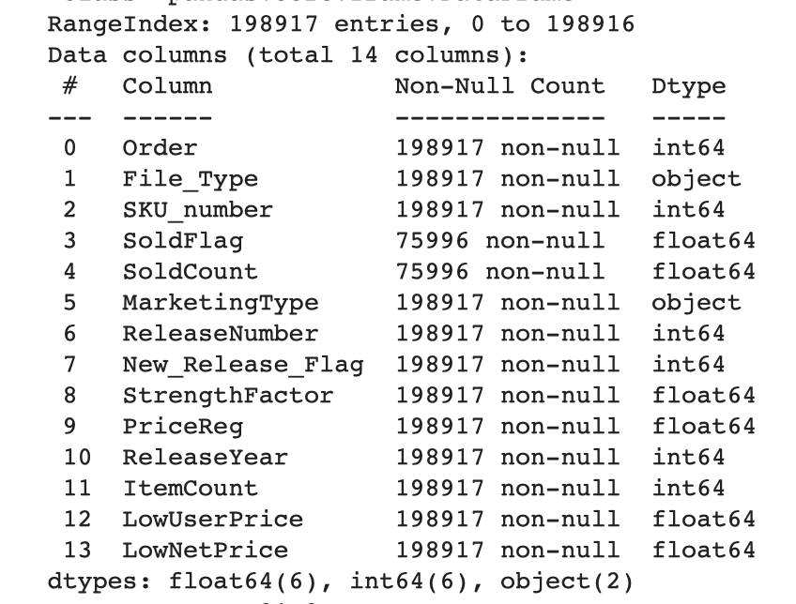
Dataset
The dataset contains a detailed set of products in an inventory .
The file contains the observations of both historical sales and active inventory data.
The dataset contains 198,917 rows and 14 columns with 12 numerical and 2 categorical columns. There are 122,921 actively sold products in the dataset.
The end solution here is to create a model that will predict which products to keep and which to remove from the inventory.

Slide 5
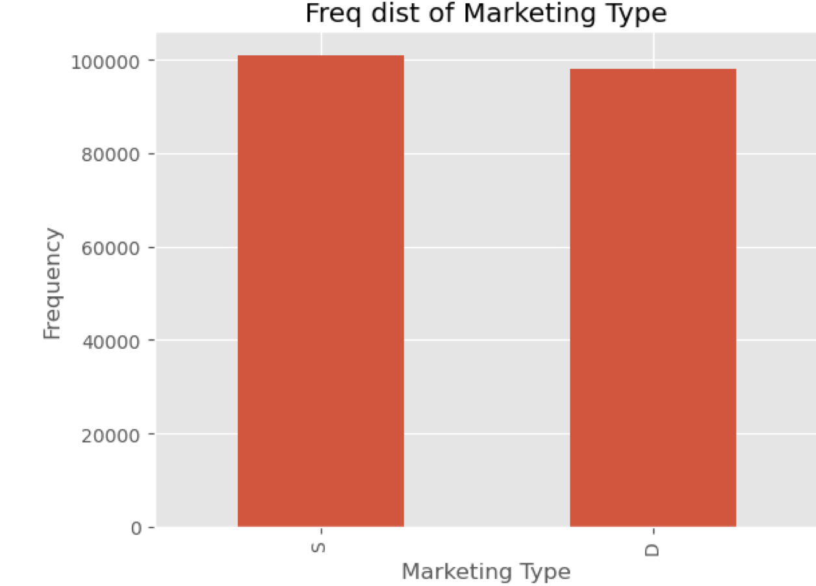
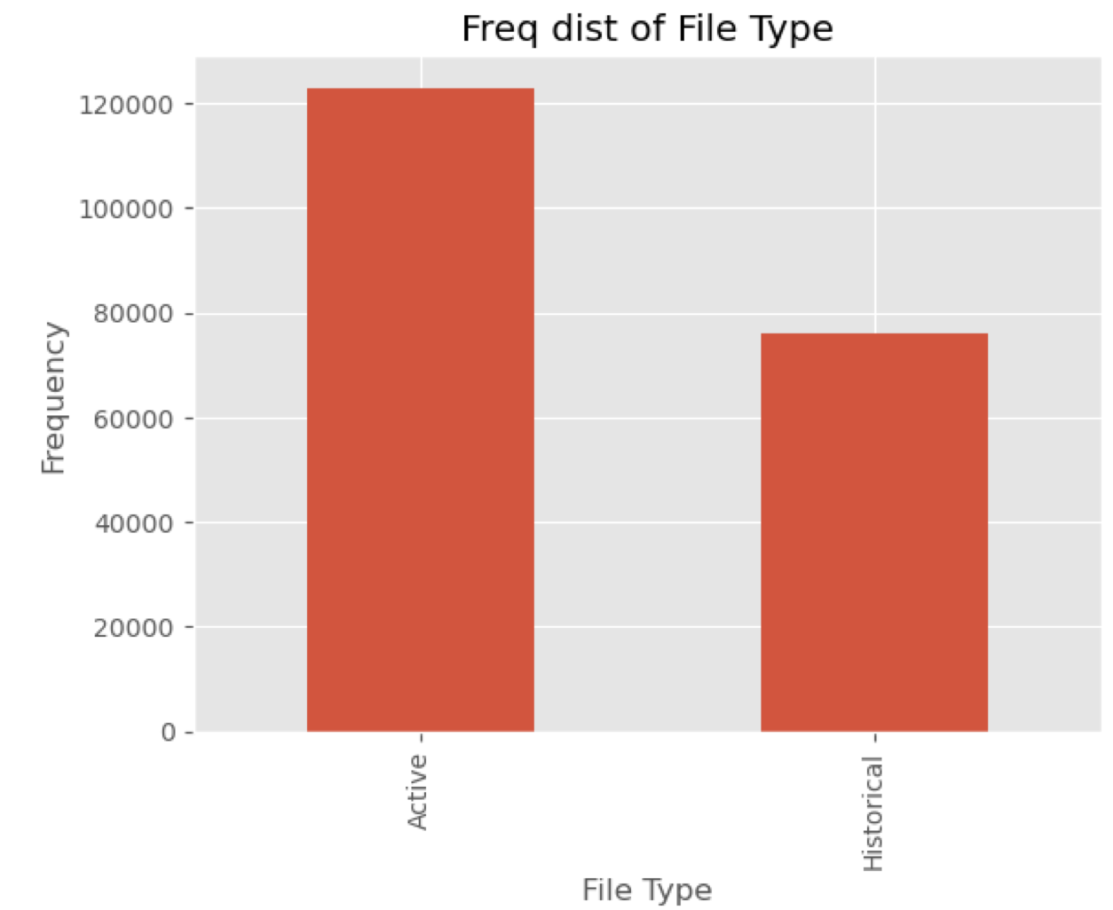
Univariate distribution plots
This section shows a frequency histogram for the selected variable along with the density and normal curves for the dat.
The box plot shows the basic statistics of the data like median, 25th and 75th quantiles and the outliers.
The univariate distribution plots are graphs where we plot the histograms along with the estimated probability density function over the data. The univariate analysis for numerical and categorical attributes are different.

Slide 6
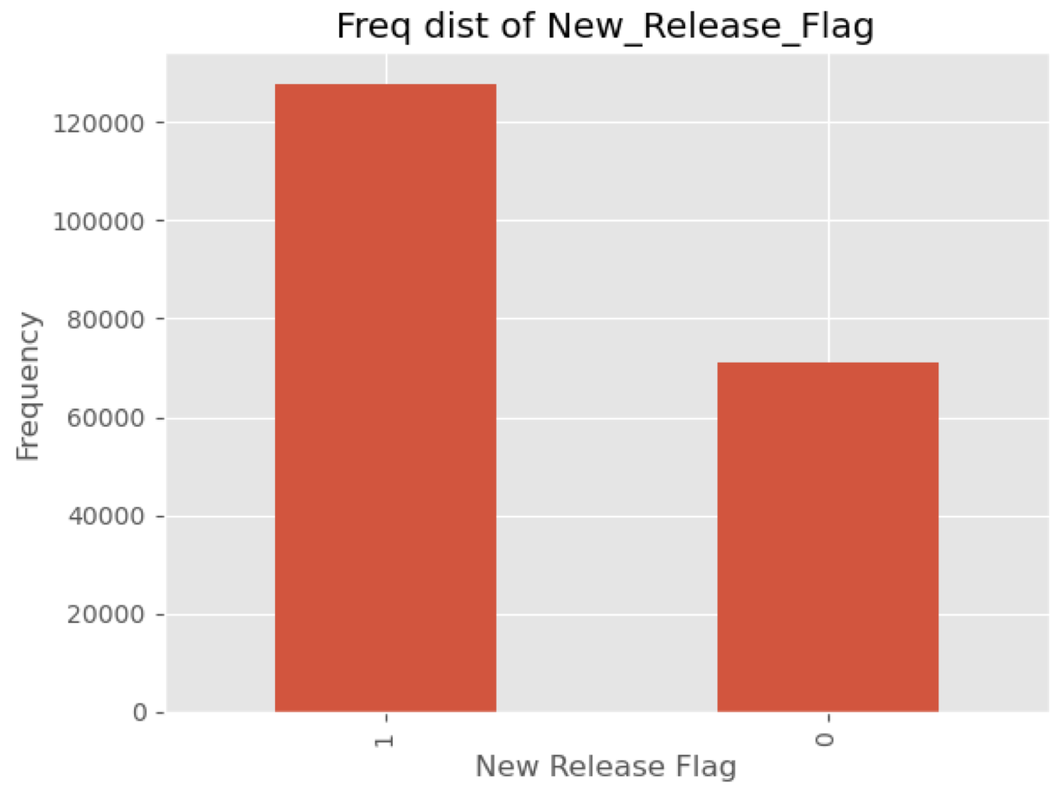
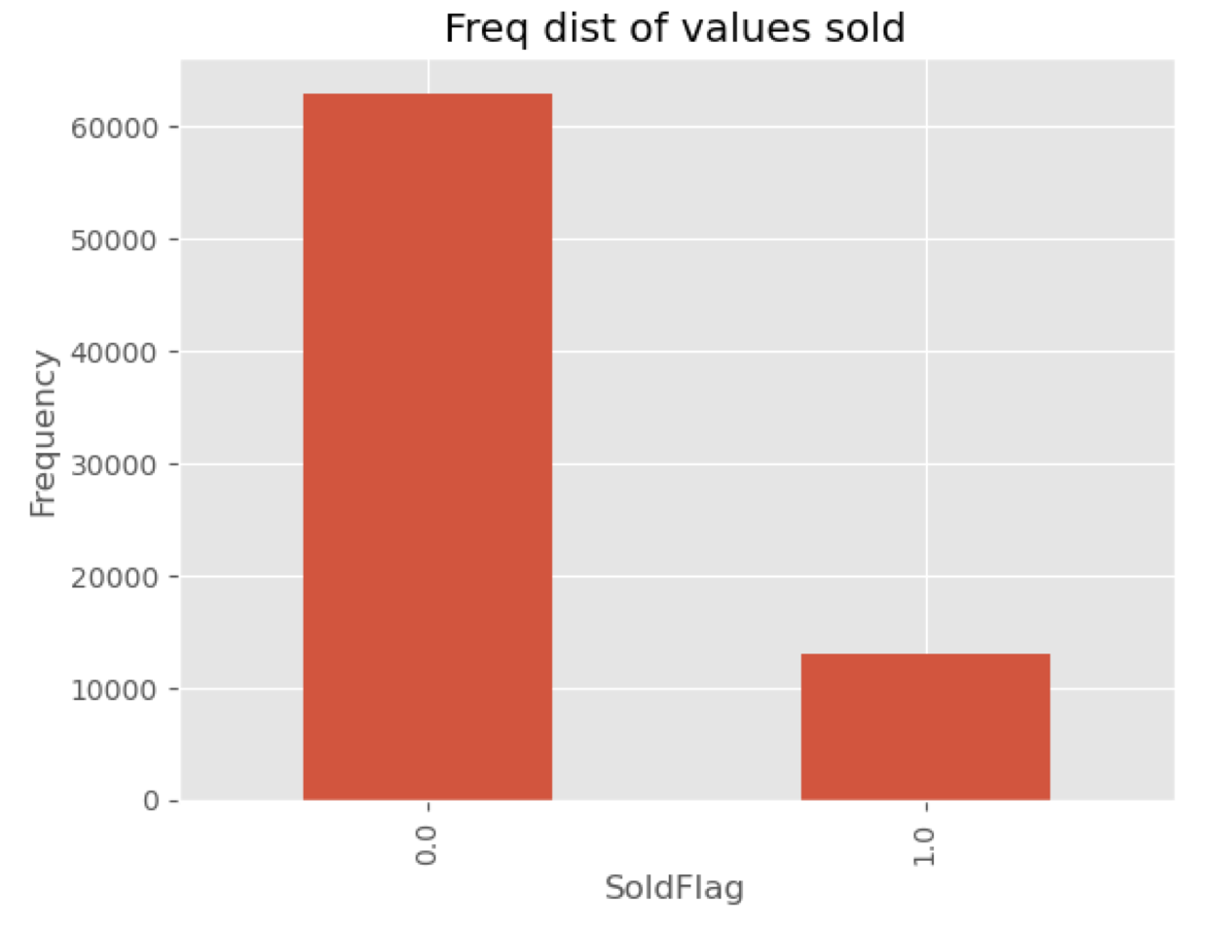
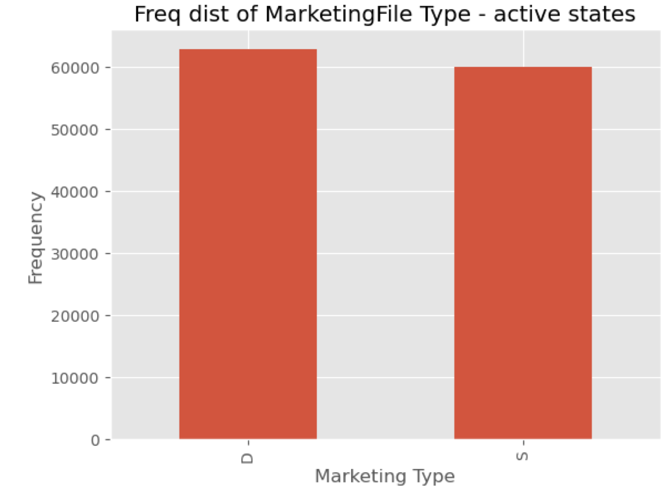
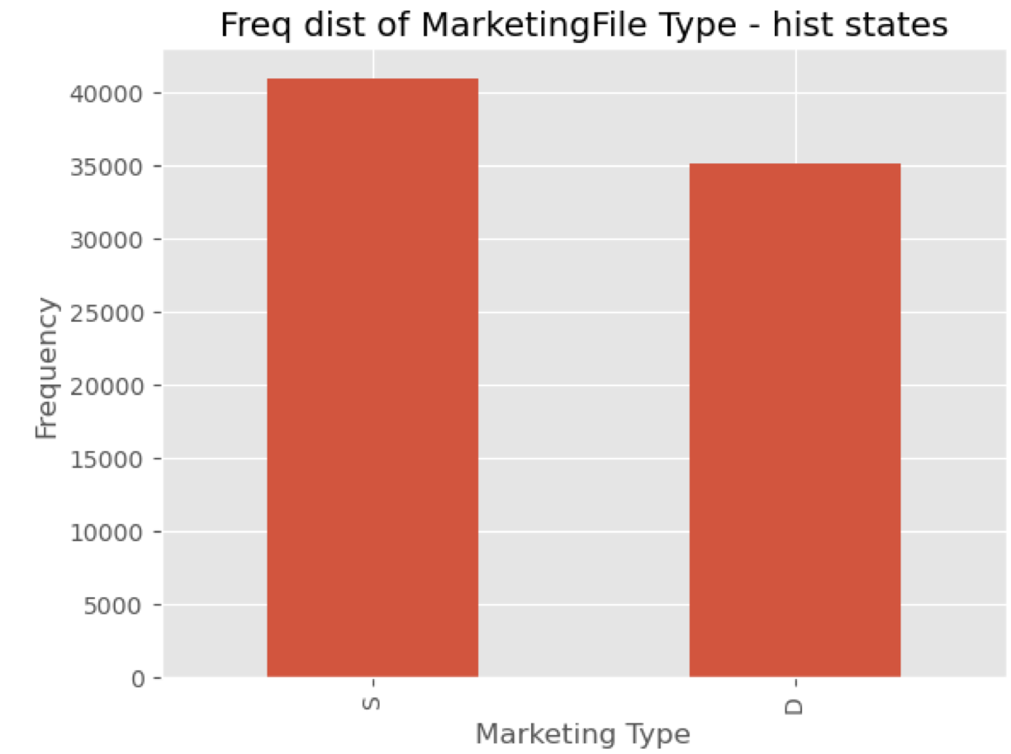
Univariate distribution plots

Slide 7
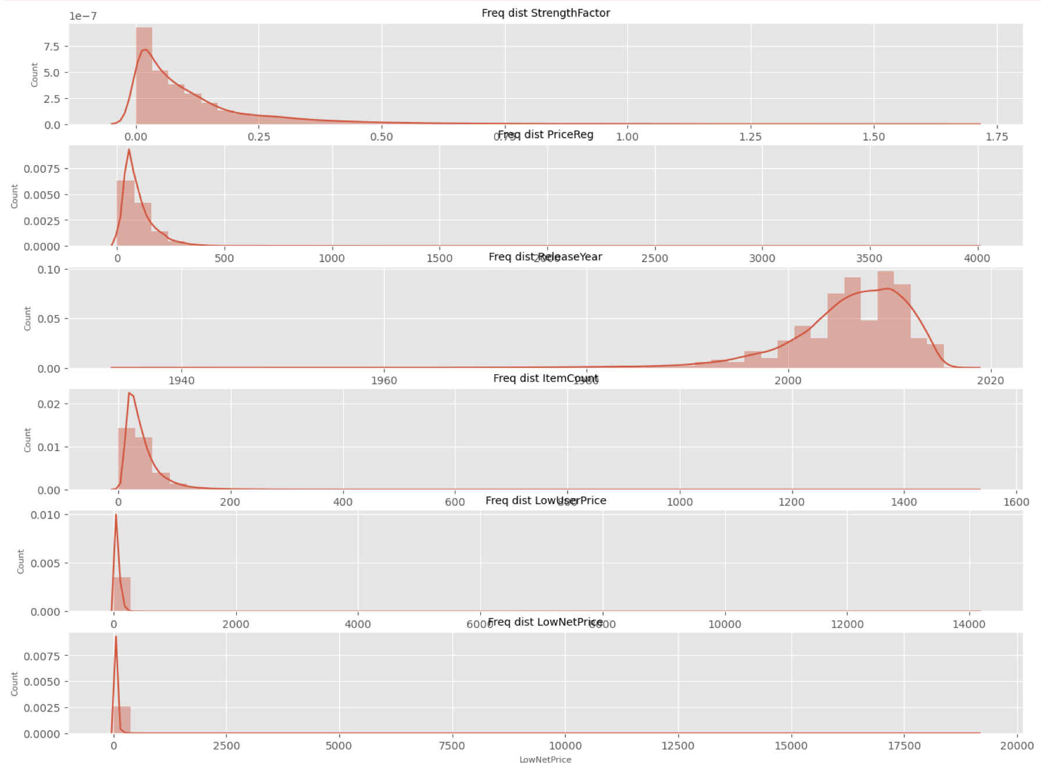
Univariate distribution of the numerical columns containing histograms and the estimated PDF.

Slide 8
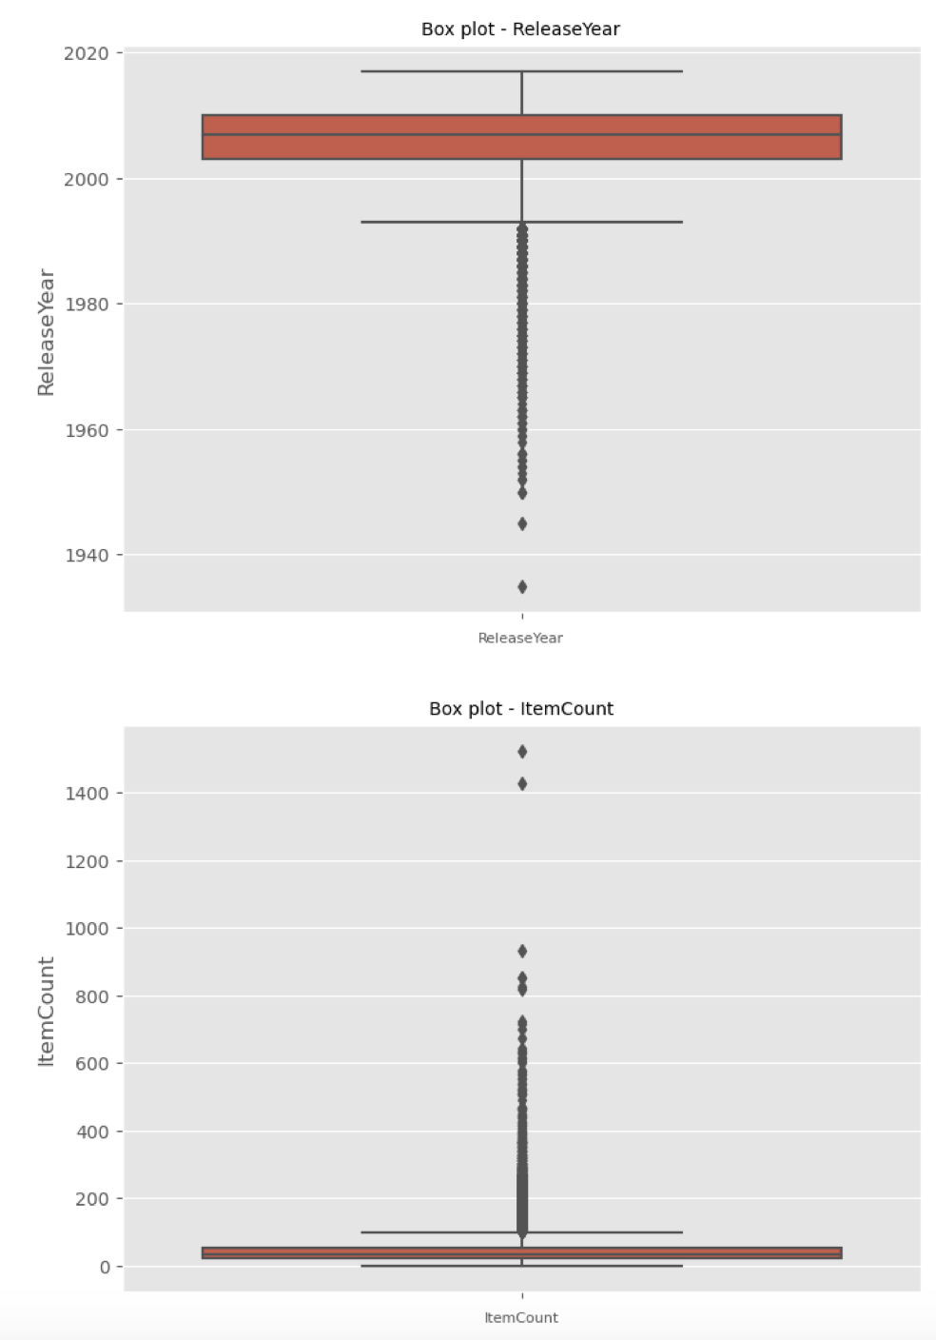
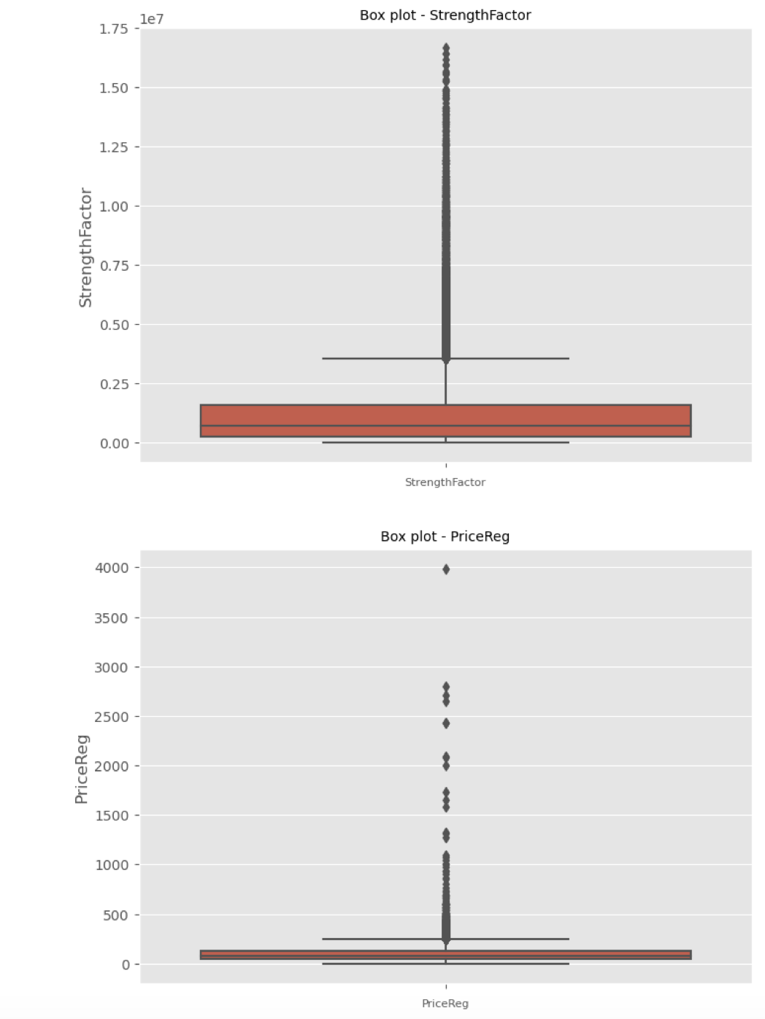
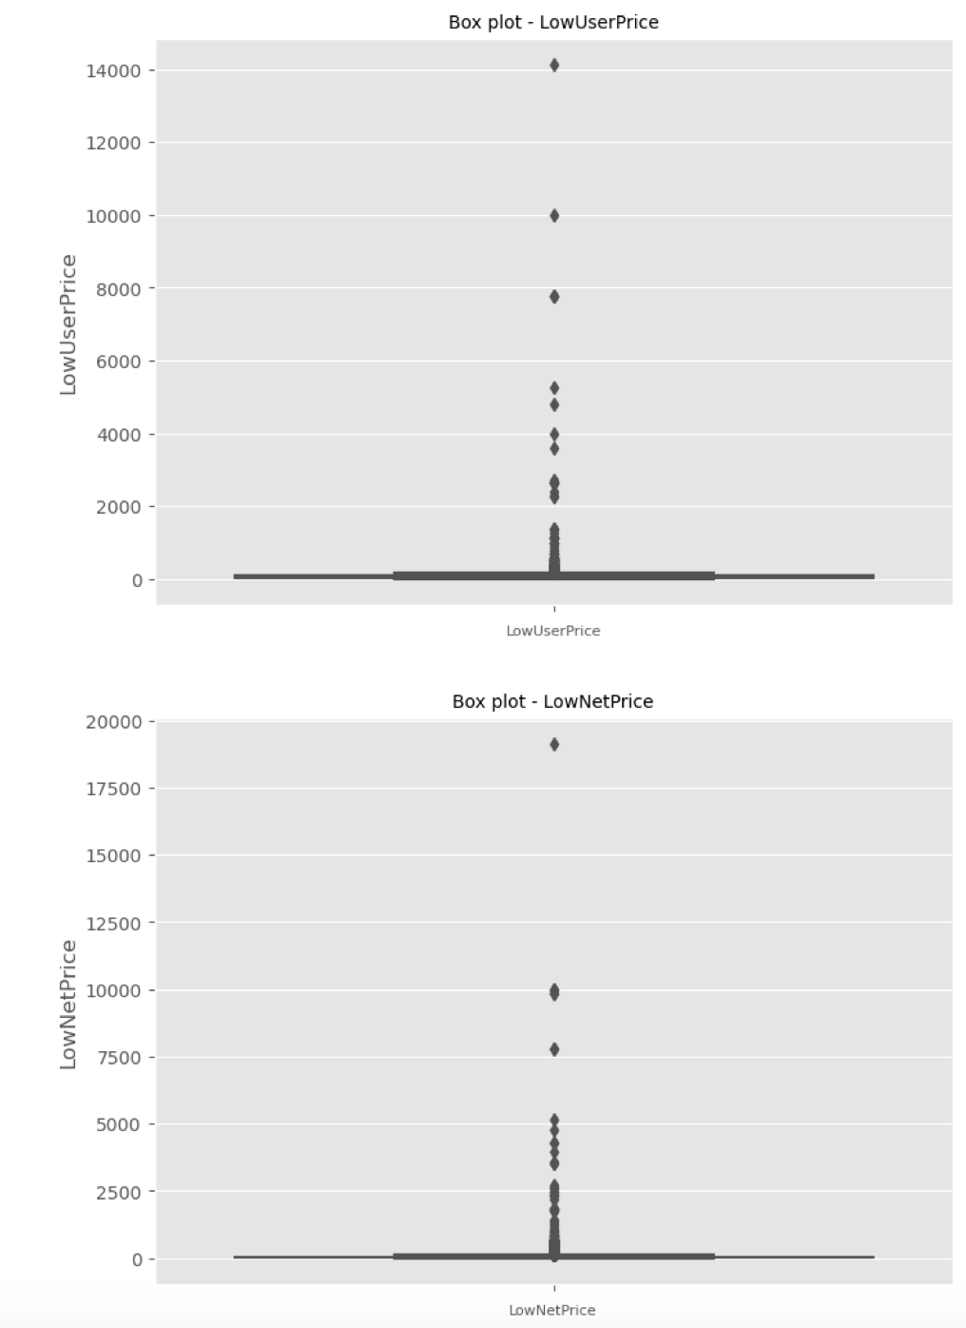
Outlier detection analysis

Slide 9
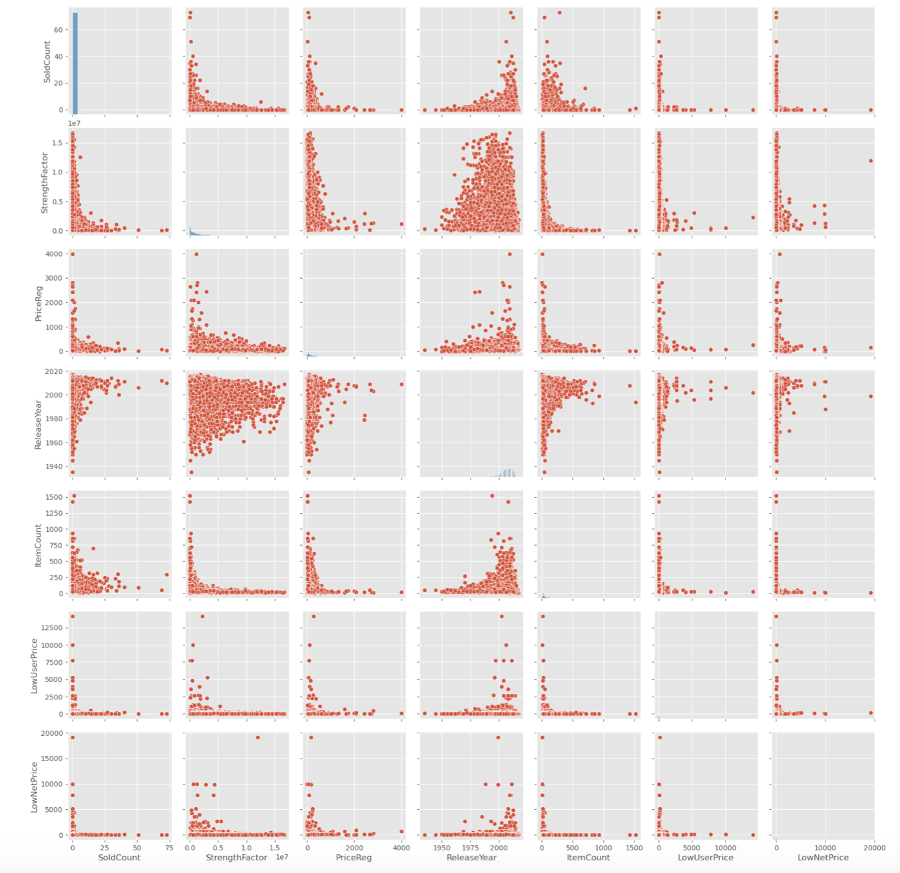
Bivariate plots
To plot multiple pairwise bivariate distributions in a dataset We can see that leaving the ReleaseYear column every other column is skewed to the left which indicates most of the values lie in the lower range values and vice versa in the case of a ReleaseYear attribute.
The bivariate distribution plots help us to study the relationship between two variables by analyzing the scatter plot, and we use the pairplot() function of the seaborn package to plot the bivariate distributions.
We often look out for scatter plots that follow a clear linear pattern with an either increasing or decreasing slope so that we can draw conclusions, but don’t notice these patterns in this particular dataset. That said, there’s always room to derive other insights that might be useful by comparing the nature of the plots between the variables of interest.

Slide 10
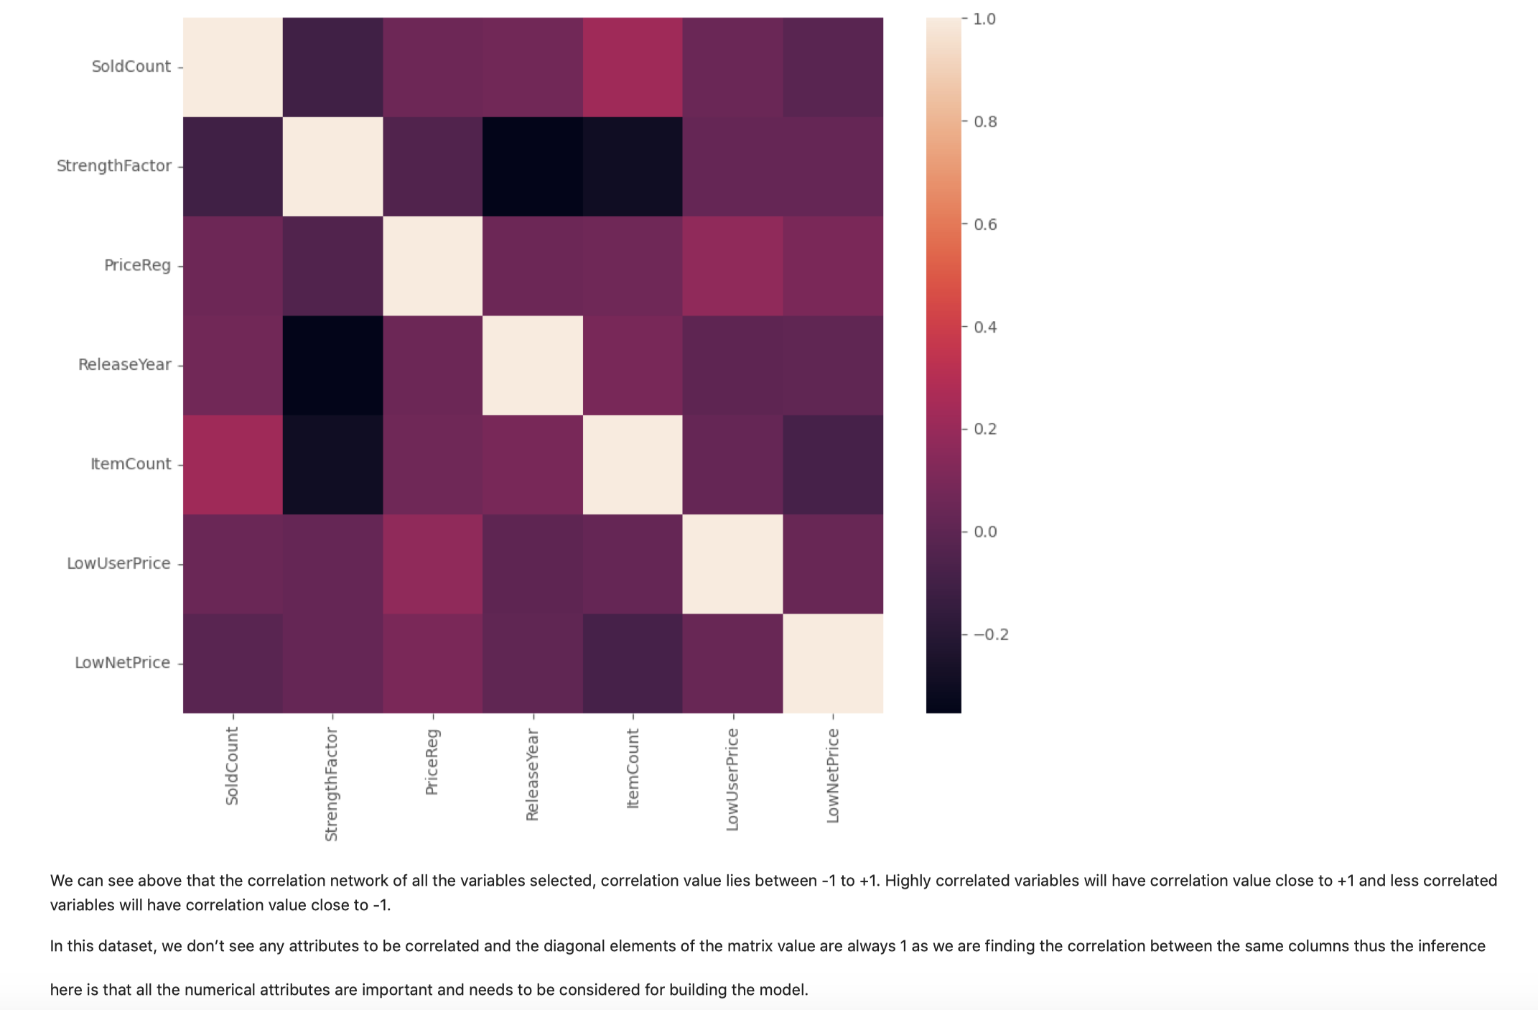
Correlation plot

Slide 11
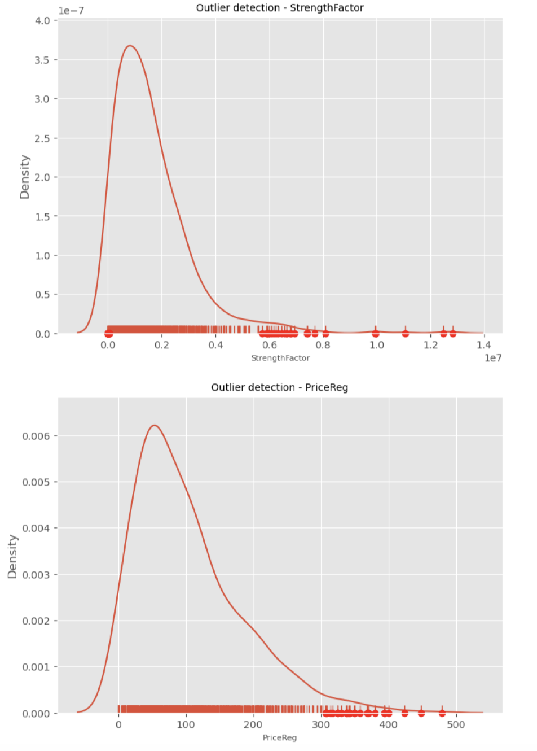
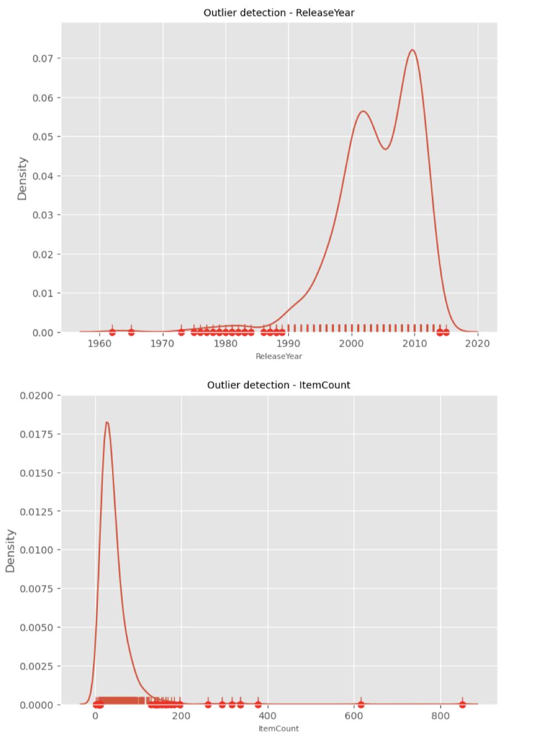
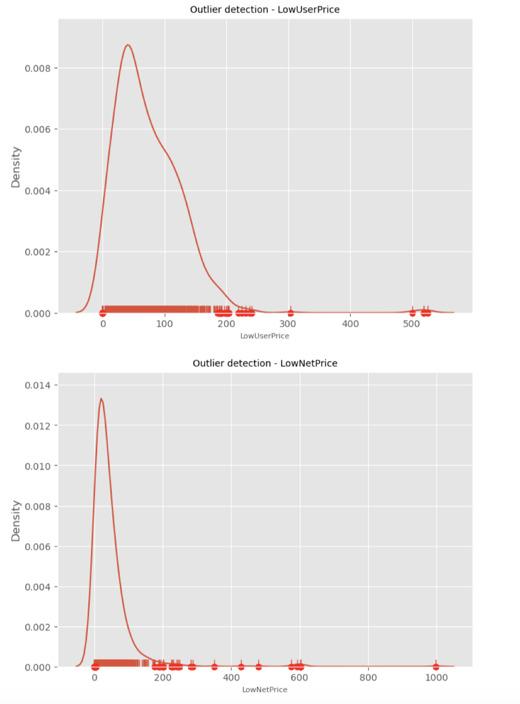
Univariate Outlier treatment
Many algorithms are sensitive to the range and distribution of attribute values in the input data. Outliers in input data can skew and mislead the results and make results less reliable, that’s why we have to recognize all the outliers and treat them.
Values marked with a dot below in the x-axis of the graph are the ones that are removed from the column based on the set threshold percentile (95 in our case), and is also the default value when it comes to percentile-based outlier removal.

Slide 12
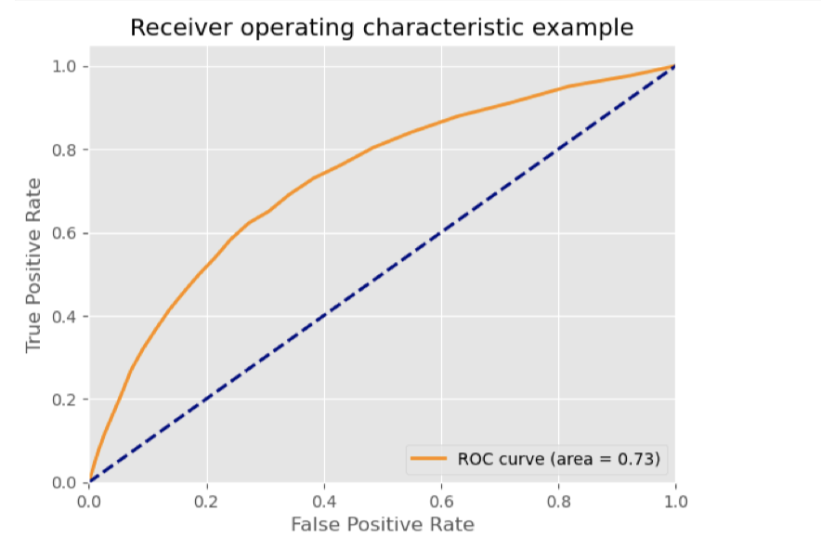
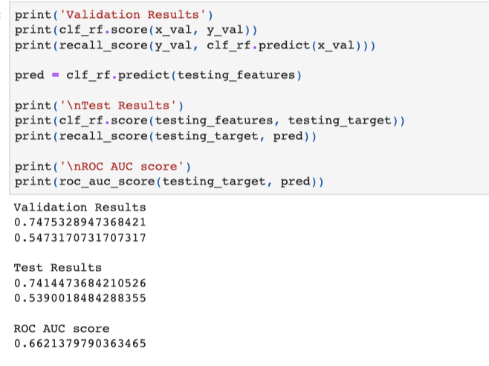
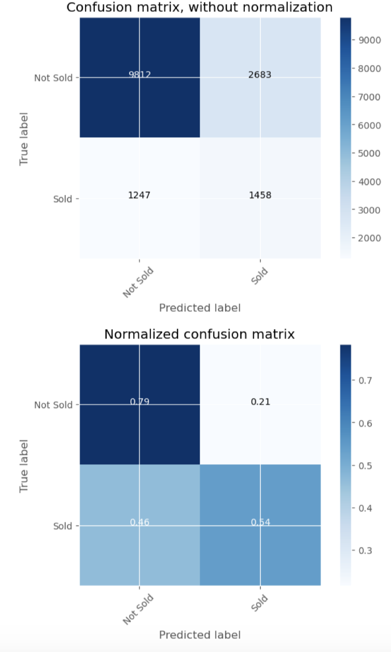
Predictive Modelling
1. The classification module predicts the SKU which needs to kept in the inventory (Active state).
2. Balancing the classes using SMOTE
3. Used RandomForestClassifier for modelling.

Slide 13
Statistical Hypothetical question Summary
Outcome of your EDA
○ Context: A retail firm has many products in their inventory, and very few of them tend to sell (only about 10% sell each year) and many of the products only have a single sale in the course of a year
○ Objective: The sales and growth team of the retail firm wants to determine which products from their inventory should they retain to sell and the ones to discard. The outcome of the project is to build a binary classifier which gives us a list of product ID which need to retained in the inventory or list of products that need to be removed.
What do you feel was missed during the analysis?
○ I feel like I have missed using some more data modeling and prediction techniques like SVM and deep learning methods.
Were there any variables you felt could have helped in the analysis?
The bivariate distribution plots help us to study the relationship between two variables by analyzing the scatter plot, I have used this distribution to look out for scatter plots that follow a clear linear pattern with an either increasing or decreasing slope so that we can draw conclusions, but don’t notice these patterns in this particular dataset.

Slide 14
Statistical Hypothetical question Summary
Were there any assumptions made you felt were incorrect?
No
What challenges did you face, what did you not fully understand?
○ I could not fully understand the use other descriptive characteristics like Mean, Mode, Spread, and Tails in my dataset so I did not considered it in my analysis.
○ Initial challenge was to select the right variables for my analysis.
○ From technical perspective I had a challenge understanding random forest classifier for my dataset.

